Slide 1
PH sensor PROPOSAL
BY Kirstin thompson

Slide 2
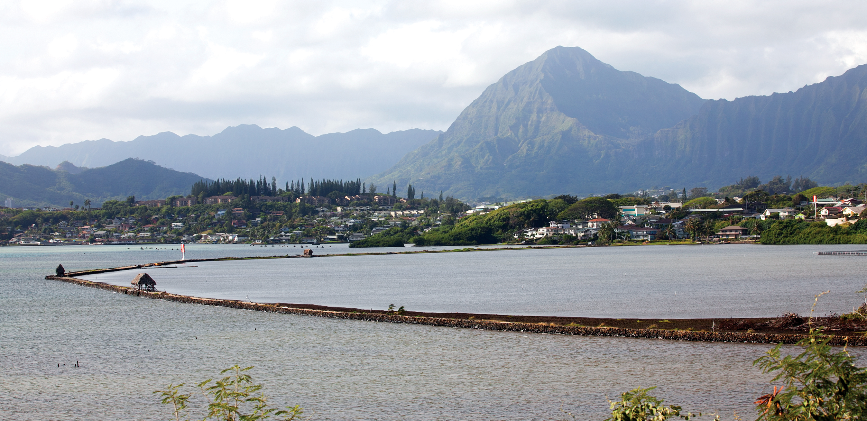
The focus
Goal: collect pH measurements in three locations in and around He’eia fishpond in order to understand the changes in pH as water cycles through the pond.
Location: He’eia fishpond is a walled (Kuapa) style fishpond with 88 acres of brackish water.
Freshwater : three Makaha connected to He’eia Stream.
Saltwater: three Makaha along the seaward edge of the pond connected directly to the ocean.
Bordered by the Malauka reef which extends out to Kane’oha Bay.
pH in He’eia Fish Pond

Slide 3
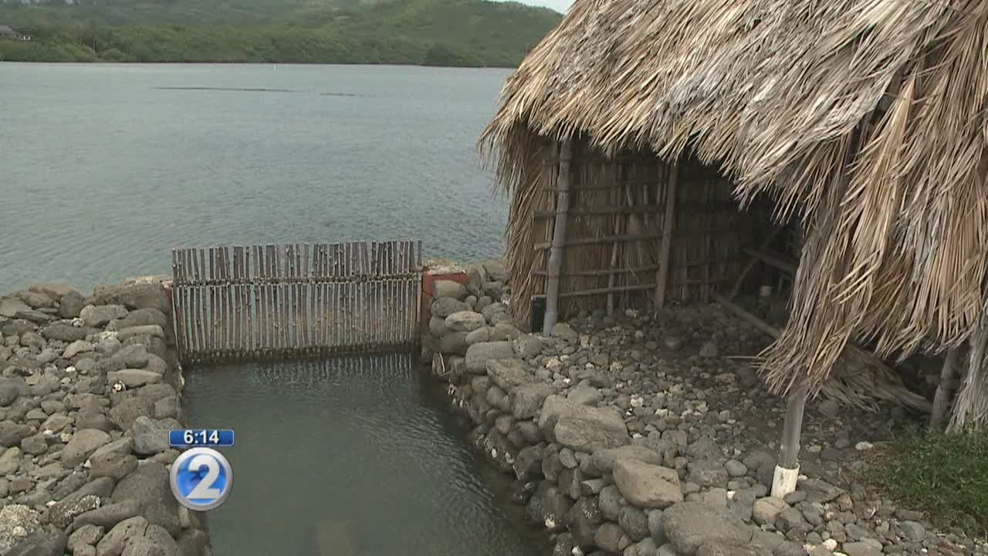
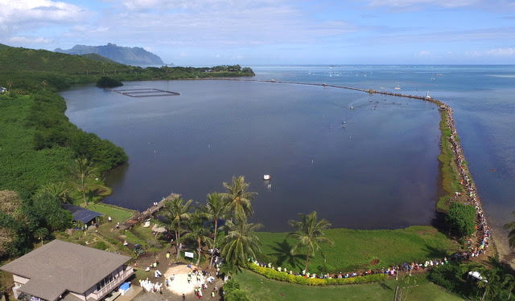
The sampling regime
Spatial Sampling Regime: Measurements taken 1) In He’eia Stream, a predetermined number of meters upstream from the Makaha openings, 2) A location inside the pond along the interior of the portion of the wall bordering the ocean, and 3) a location outside the pond along the exterior of the wall.
The duration and longevity of the sampling is dependent upon the stability of the pH sensor to maintain accurate readings over long periods of time. Higher cost sensors are more stable however use of low cost pH sensors are more feasible with the given budget, could contribute to improved development of affordable sensors, and can be replicated at other sites at low cost.

Slide 4
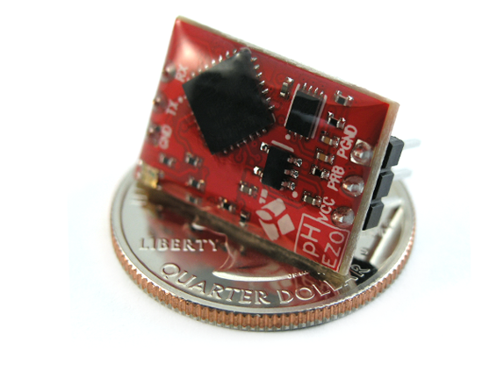
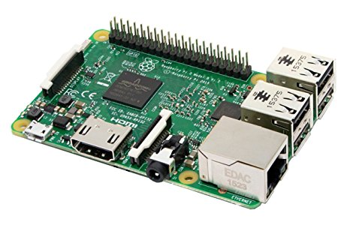
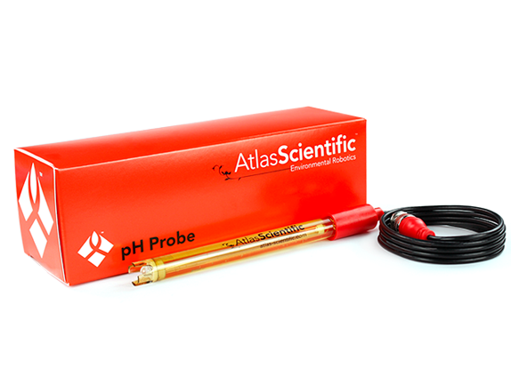
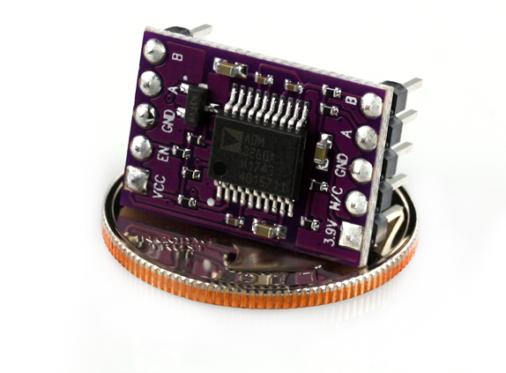
The components
Rasberry Pi (Provided)
pH Probe ($75) Atlas Scientific
EZO pH Circuit ($40) Atlas Scientific
EZO inline Voltage Isolator ($26)
Batteries
Rough Estimate: $150

Slide 5
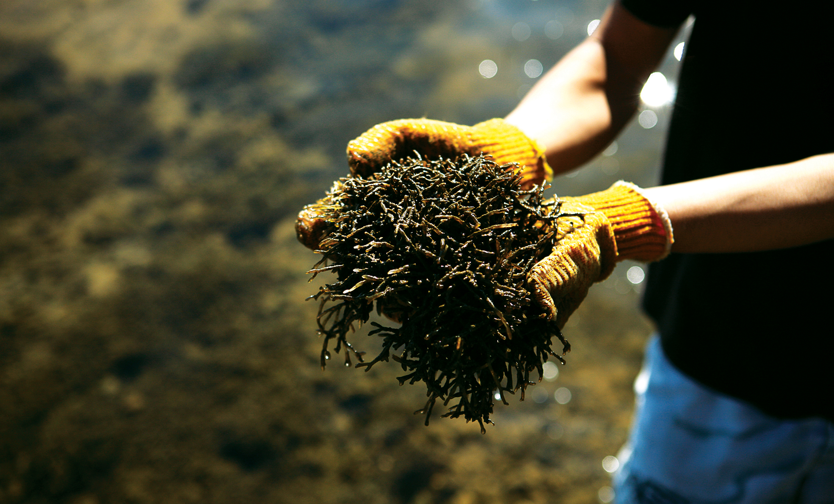
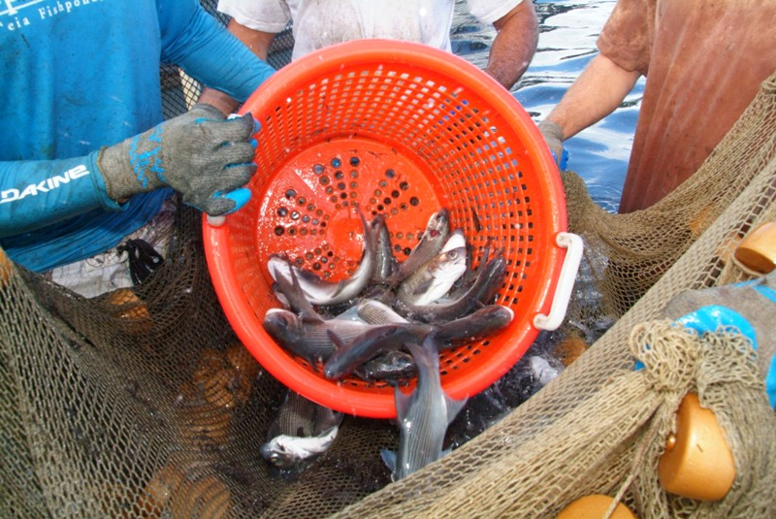
The Potential impact
Lead to more informed environmental management and aquaculture decisions at He’eia and elsewhere.
Acidification of the water within the pond could affect productivity of various species being cultivated
Limu ((G. salicornia/Gorilla Ogo)
Moi (Pacific Threadfin
Other fish in pond: ‘ama’ama, awa, pualu, palani, aholehole, kokala, kākū, and papio
Potential for oyster cultivation
Effects on the surrounding reef: coral is sensitive to ocean acidification and might be affected by the water being deposited from the pond

